Slide 1

IX Intercom application for PC
IX-SOFT
QG63022A

Slide 2

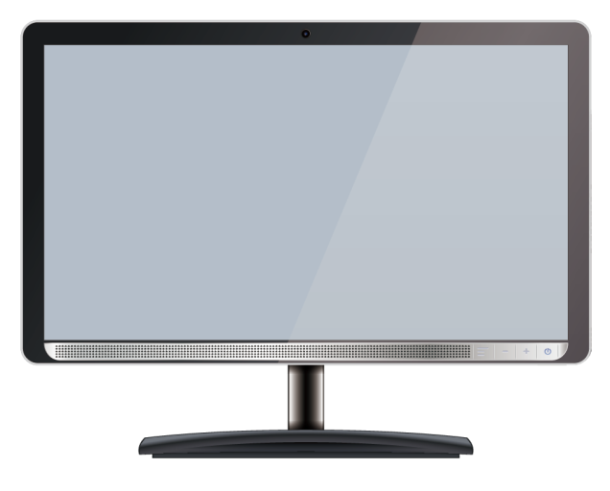
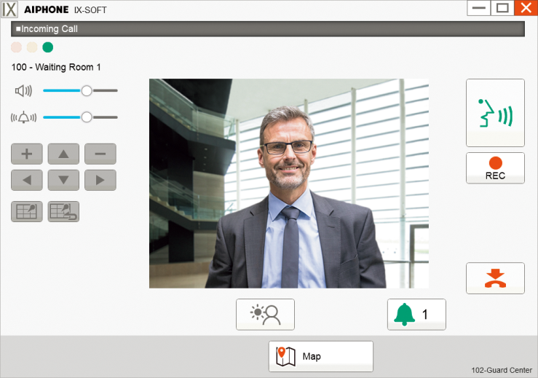
Introduction
Easy-to-Use PC Master Station Software with Intuitive Interface
What kind of benefits using software?
■Computer screen offers
a larger viewing platform
■Reclaim valuable desk
space
■Can be used anywhere
connected to the network
■Interactive Map

Slide 3
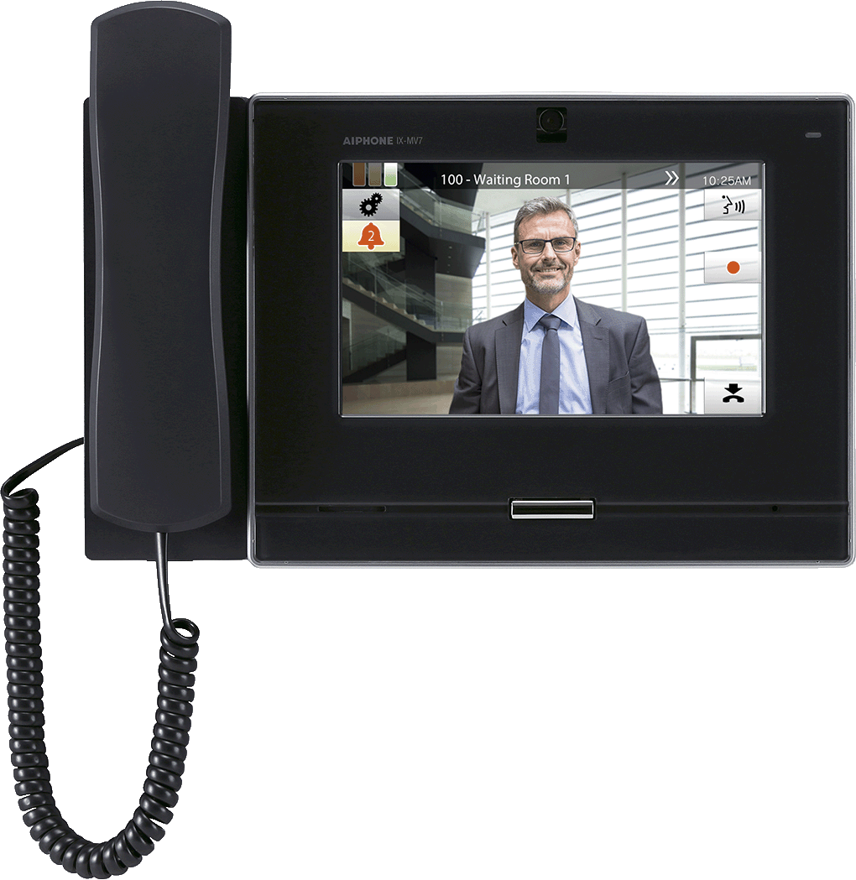
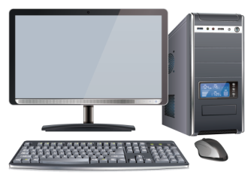
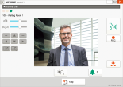
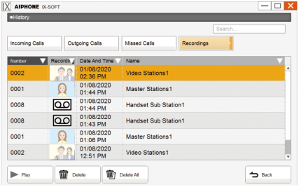



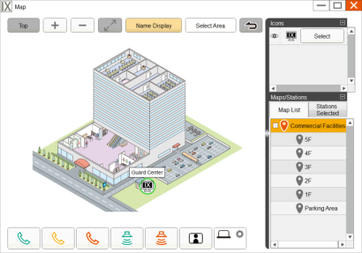
Outline
Basic Features
Same features as a physical IX master station
Recording on PC
Record conversation video and audio
Up to 50 Speed dial buttons
Can be used to perform a function quickly
Interactive Map
Operation and check from bird's eye view

Slide 4


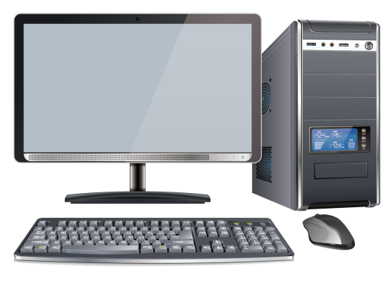

Basic Features
The software offers the same features as a physical IX master station.
IX-SOFT ^{*1}
License authentication
USB dongle ^{*2}
*1.Download the software from our website (https://www.aiphone.net/) to the PC.
*2.USB dongle must be connected to the PC while using the software.

Slide 5

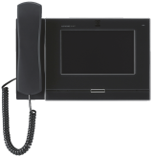
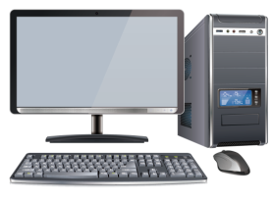
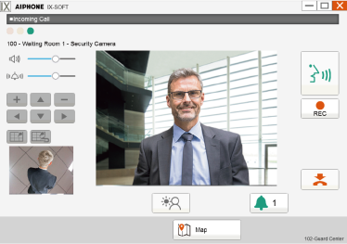






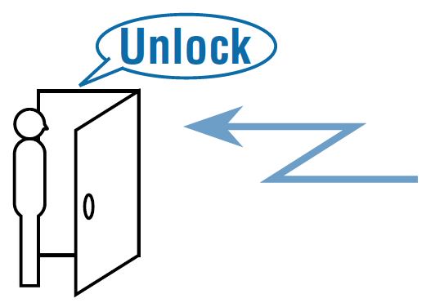




Basic Features
Video & Audio communication with station by PC
Simultaneous video from door station and network camera
Unlock the door after verifying visitor
Page to all stations or individual groups

Slide 6

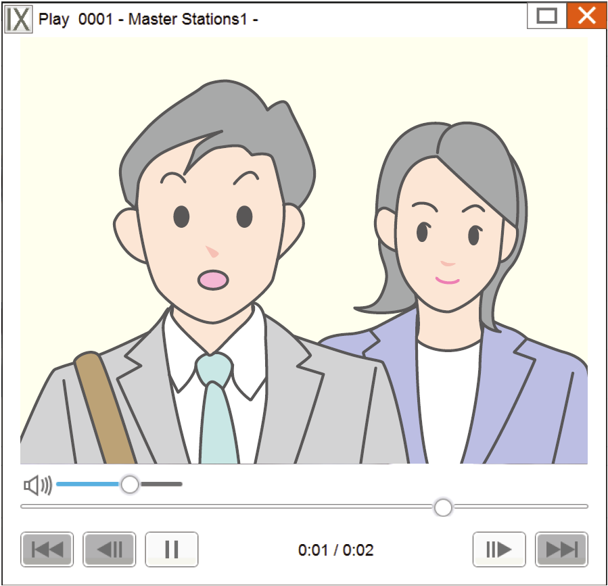





Recording on PC
The software can record the video and audio from conversations automatically or manually.
Recording history
Up to 999 recorded files can be saved.

Slide 7
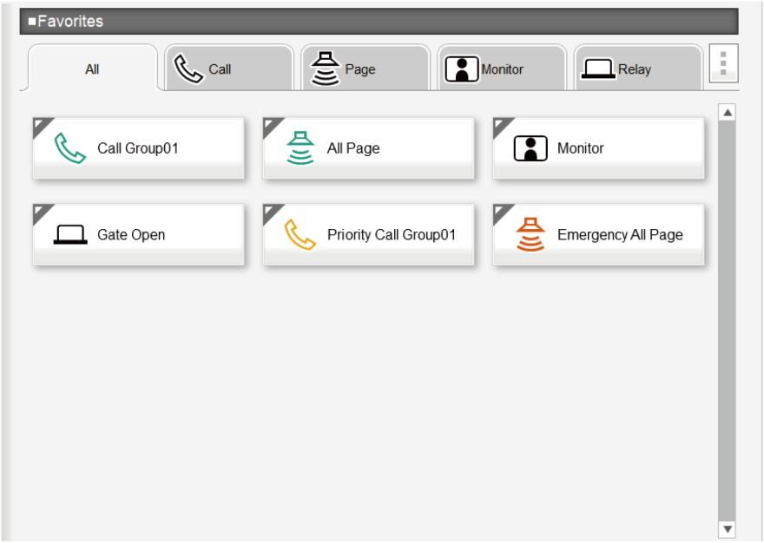
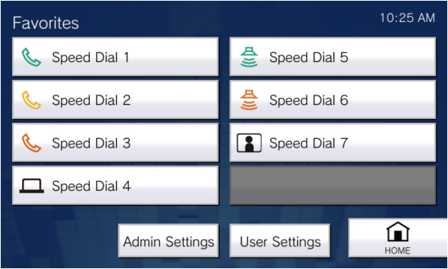
Up to 50 Speed dial buttons
The Speed Dial buttons can be used to quickly perform functions that have been pre-assigned.
IX-SOFT
IX-MV7
Up to 50
Favorite Buttons
Up to 8
Favorite
Buttons

Slide 8
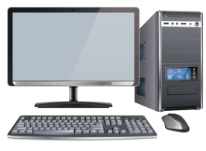
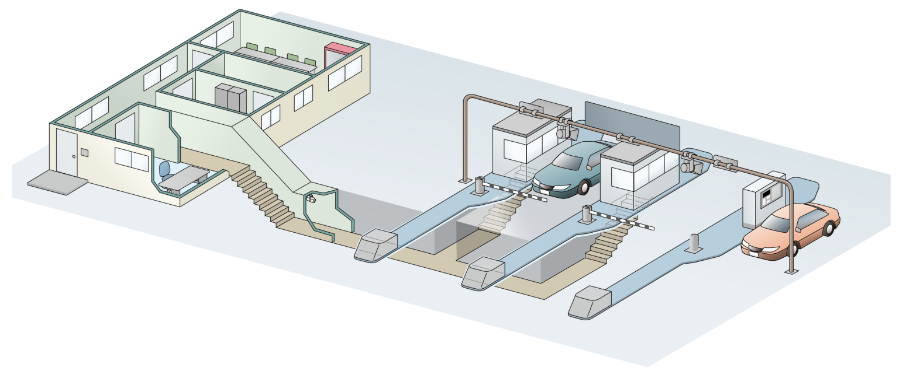
Up to 50 Speed dial buttons
■Examples of Highway toll gate
It's easy to call many toll booths from the toll office.
Toll office
Call
Call
Toll booth
Toll booth
・・・

Slide 9
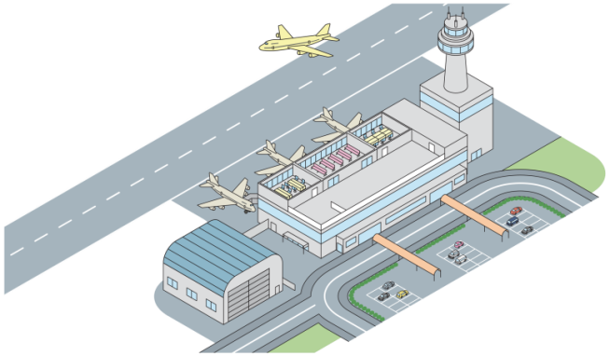


Up to 50 Speed dial buttons
■Examples of Airport
Ideal for calling and monitoring door stations and network cameras installed at each boarding gate.
Staff room
Monitor
Monitor
Call
Call
Boarding gate

Slide 10

Interactive Map
Interactive map allows system operation and status from a bird's eye view via station icons.
Station (icon) displayed on a map
Function buttons

Slide 11
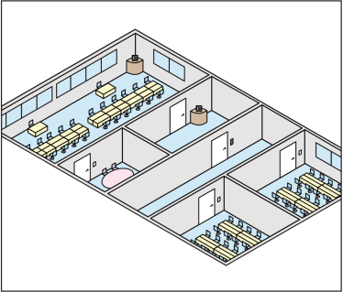

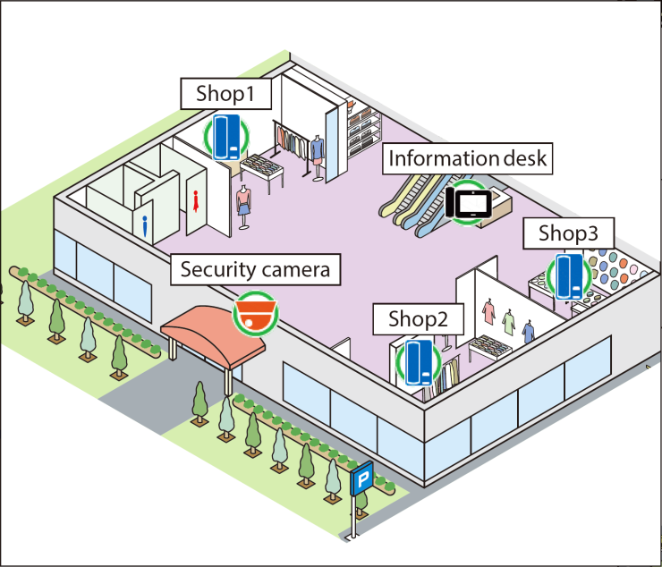
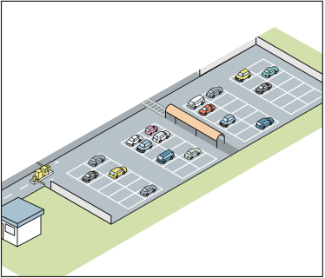
Interactive Map
Layering maps provides the ability to zoom into specific areas for easier selection. (campus, building, floor, etc.)
Map list

Slide 12
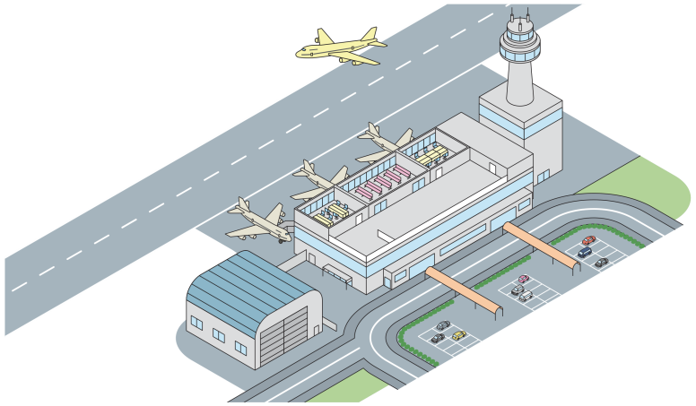
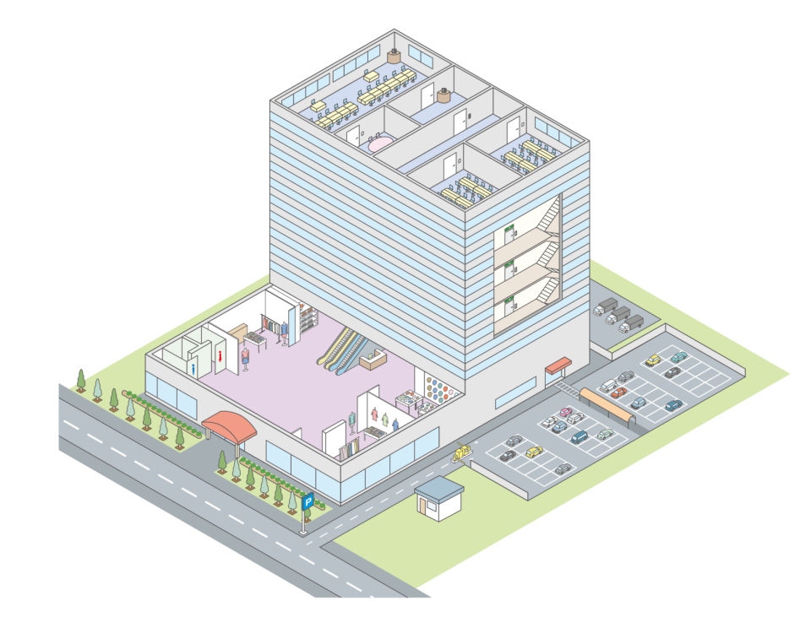
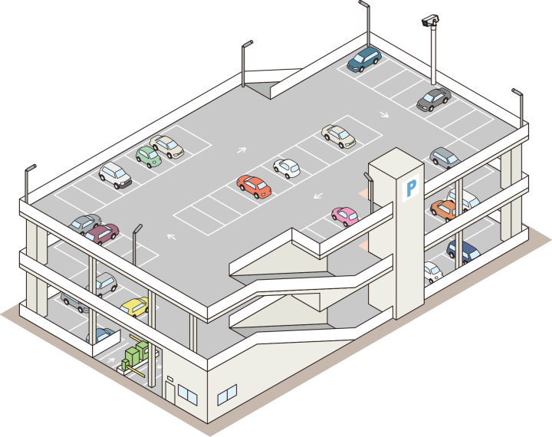
Interactive Map
■Examples of popular applications
Airports
Commercial facilities and offices
Parking facilities

Slide 13


